Slide 1
Road accidents in Belgium
Francois Montoisy
IBM – Coursera: Capstone project

Slide 2
Purpose
Give car drivers the probability of getting a severe accident
Severe = Deads or Severly Injured
Under specific circumstances, warn drivers about high risks of severe accidents

Slide 3
Data Set
Car accidents in Belgium from 2005 to 2019
SOURCE: https://statbel.fgov.be/en/open-data?category=162.
26 variables (presented next slide), 655 467 observation

Slide 4
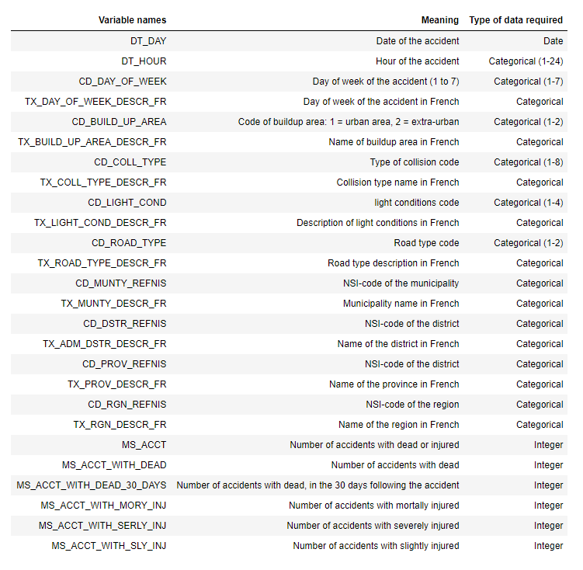
Data Set Variables

Slide 5
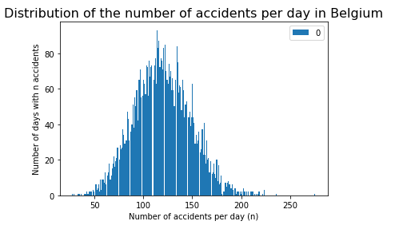
Exploratory Data Analysis

Slide 6
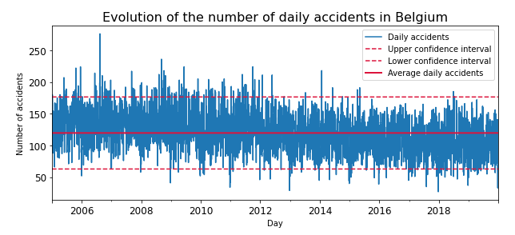
Exploratory Data Analysis (cont’d)

Slide 7
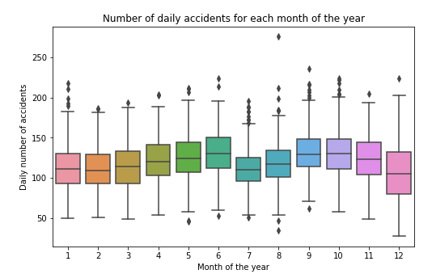
Exploratory Data Analysis (cont’d)

Slide 8
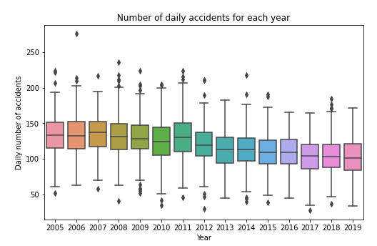
Exploratory Data Analysis (cont’d)

Slide 9
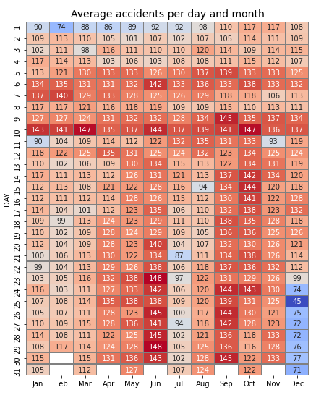
Exploratory Data Analysis (cont’d)

Slide 10
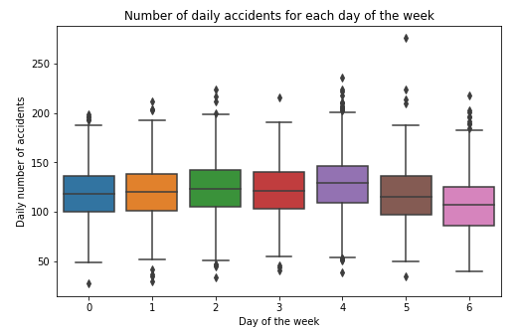
Exploratory Data Analysis (cont’d)

Slide 11
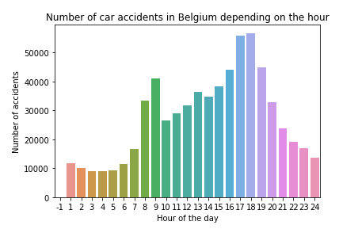
Exploratory Data Analysis (cont’d)

Slide 12
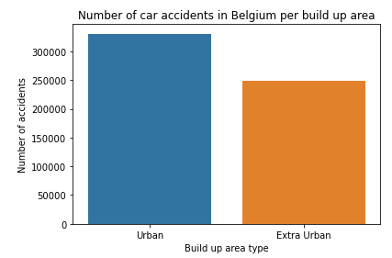
Exploratory Data Analysis (cont’d)

Slide 13
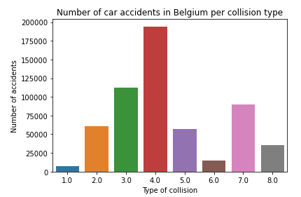
Exploratory Data Analysis (cont’d)

Slide 14
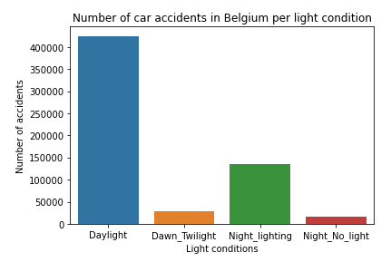
Exploratory Data Analysis (cont’d)

Slide 15
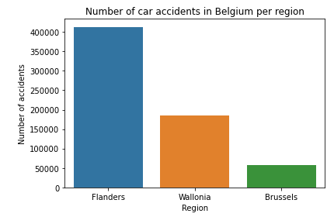
Exploratory Data Analysis (cont’d)

Slide 16
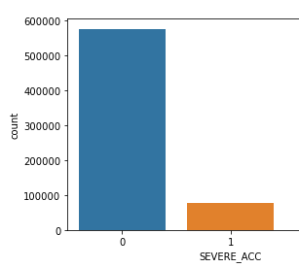
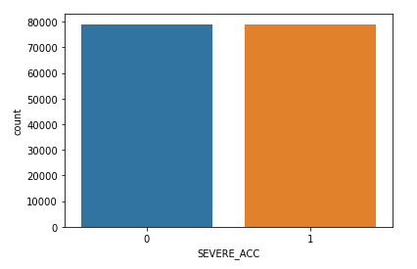
Undersampling
BEFORE
AFTER

Slide 17
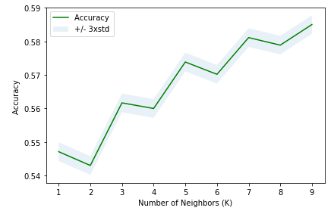
Results: K-Nearest Neighbors
Test Set accuracy for k = 9:
0.585

Slide 18
Results: Decision Trees Algorithm
Test Set accuracy: 0.604
Better results than K-NN, but can be improved again

Slide 19
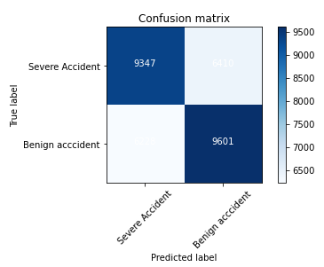
Results: Logistic Regression
Test Set accuracy
0.668
=> Our best Algorithm

Slide 20
Conclusion
Logistic regression: Accuracy of severe accidents = 66.8%
Useful for all drivers
Interesting feature to add on GPS

